Slide 1
Psychiatric Consultation-Liaison Services
Heather Lincicome, LCSW, FACHE
Chief Liaison Officer of the Apalachee Center and TMH Service Line Administrator

Slide 2
Tallahassee Memorial Healthcare
TMH is a private, not-for-profit community healthcare system serving a 21- county region in North Florida and South Georgia
772-bed acute care hospital (surgery and adult ICU)
Multiple Specialty Care Centers (NICU, Level II Trauma Center, Pediatric Specialty Care)
Operates two distinct Emergency Departments (one on main campus and one remote)
Psychiatric Hospital
Partnerships include several critical access hospitals, Apalachee Center, and Florida State College of Medicine
TMH Behavioral Health Center 60 bed inpatient psychiatric hospital (standalone)
Adult Intermediate Care Unit
Adult Specialty Care Unit
Child and Adolescent Unit serving 6-17 yrs.
Outpatient Psychiatry and Psychotherapy Services
Psychiatric Consultative Liaison
Soon to come PHP/IOP

Slide 3
Challenges with Behavioral Health Integration and Acute Care Hospitals
Prior to 2019 the Behavioral Health Center had sometimes functioned as a stand-alone subspecialty within the TMH system.
The BHC served as a very effective treatment unit for chronic behavioral health diseases in their acute phase, but its stand-alone position had created challenges in providing best-practice rapid comprehensive behavioral health support and integration throughout the entire TMH system– especially in the Emergency Departments and on the medical/surgical floors.
Expanding behavioral health into a primary medical/surgical system-wide integrative role required systemic and cultural growth for BHC and the TMH system as a whole.
The critical priority of behavioral health expansion and integration focused on patients identified in the ED needing psychiatric assessment and admission be rapidly transferred to inpatient care or released from the Baker Act if prudent

Slide 4
Transition and pathway to behavioral health integration
Behavioral Health and Emergency Department Leadership forged an alliance and developed mutually beneficial objectives and goals as it relates to emergent psychiatric care:
Develop and Expand Psychiatry Consultation Liaison Team (systems level care comparable to collaborative outpatient models)
Interdisciplinary Model (diverse behavioral health disciplines with focus on individualized patient need)
Systemic Screening (Consistent evidenced-based screening tool for all patient settings)
Early Clinical Intervention (minimize delays in onboarding in ED, apply preventative medicine and stabilization)
Integration with primary medical teams (expertise provided within scope of practice to apply optimal treatment in ED and medical/surgical settings)

Slide 5
Creation of the Behavioral Emergency Services Team (B.E.S.T.)
BEST Team launched in January 2019 and created a team responsible for:
Psychiatric Consultations (24/7) on-site in the Bixler Emergency Department
Psychiatric Consultations (24/7) on-site on the medical/surgical floors
Social worker available to provide therapy service on medical/surgical floors
Psychiatric Telehealth with several critical access hospitals, Northeast Emergency Department, and Central Receiving Facility
Provide evening call coverage for the Apalachee Center
Team comprised of: Psychiatry, Family Practice, Psychiatric Certified Advanced Practice Registered Nurse, Physicians Assistant, Registered Nurse Social Worker, Peer Specialists
Additional Services:
Direct Admissions Department
Opioid Bridge Program
Goals:
Reduce the stigma associated with the care of mental health conditions and increase patient confidence in seeking appropriate care (reduced treatment delays)
Reduce onboarding of psychiatric patients in the Emergency Department through rapid assessments and facilitating timely dispositions to more appropriate level of care
Reduce episodes of violence or elopements associated with lengthy onboarding times and delays in necessary treatment for psychiatric patients
Provide psychiatric intervention and treatment for all patient entries and levels of care

Slide 6
How it works
Patient enters the Emergency Department (primary mental health complaint or medical issue with secondary mental health issues)
Columbia Suicide Risk Screen performed on all patients (positive answers trigger moderate-to-high suicide precautions to be implemented immediately and auto-trigger psychiatric consultation wit BEST team)
Patient is triaged and assessed by Emergency Department personnel and physician to treat medical complaints and/or medically clear
B.E.S.T. Order Placed (if not auto-triggered through suicide risk screen) and team alerted through EMR of new psychiatric consultation
B.E.S.T. team performs nursing assessment and psychiatric evaluation within an hour of received consult
B.E.S.T Team physician initiates medication orders if appropriate
B.E.S.T. team determines most appropriate disposition (inpatient admission to BHC, rescinding of the Baker Act with outpatient resources provided, patient with medical co-morbidities admitted to medical floor with continuation of psychiatric overlay services)

Slide 7
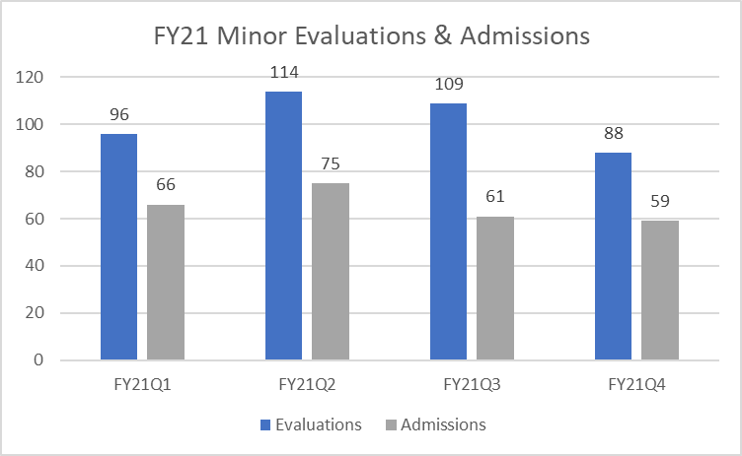
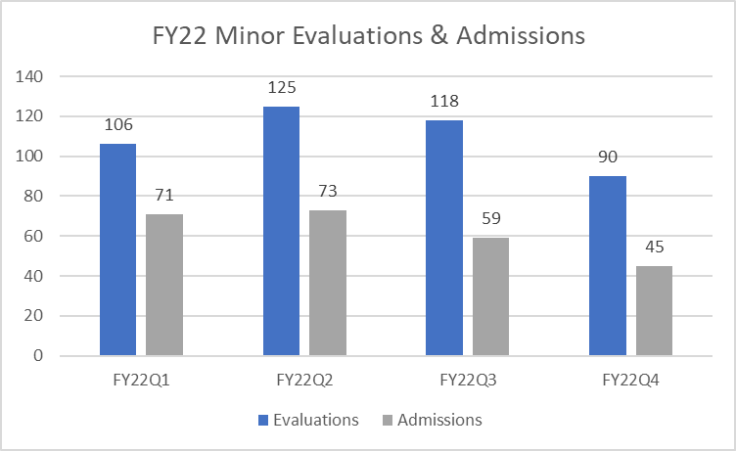
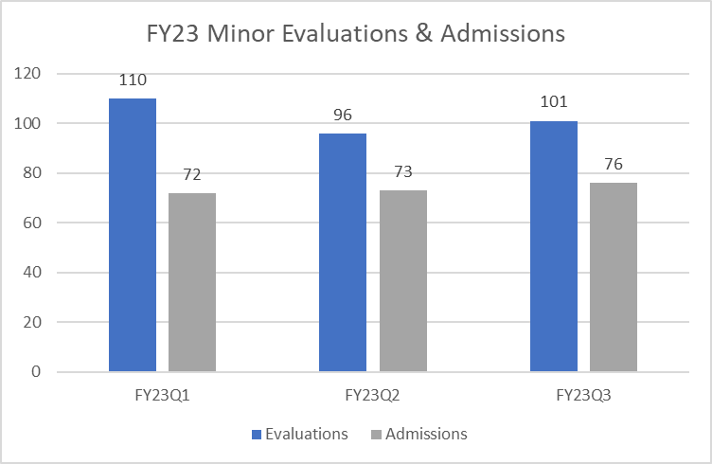
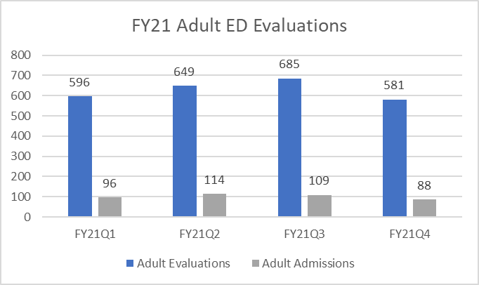
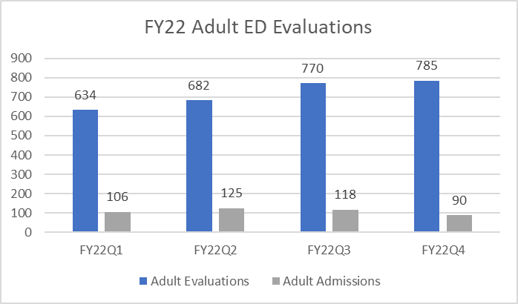
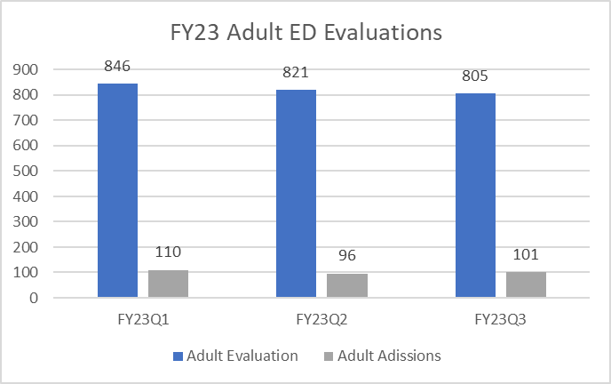
Volumes Minors and Adults FY 21/FY 22

Slide 8
Lessons Learned
Integration of behavioral and physical healthcare works when common goals/objectives are developed in collaboration
Telehealth is a game changer (especially as it relates to rural hospital networks)
Joint Ventures and Partnerships strengthen community treatment model
Continue to enhance consultative liaison team to meet the changing and diverse treatment needs of your community (bridge program, direct admissions)
Invest in sustainable organizational culture changes and get champions in both the mental and physical health worlds (i.e., ED physicians, Hospitalists, Psychiatry, Social Work)
Drastically reduces treatment delays with average patient time spent in ED less than 8 hours before transitioning to appropriate disposition

